Slide 1
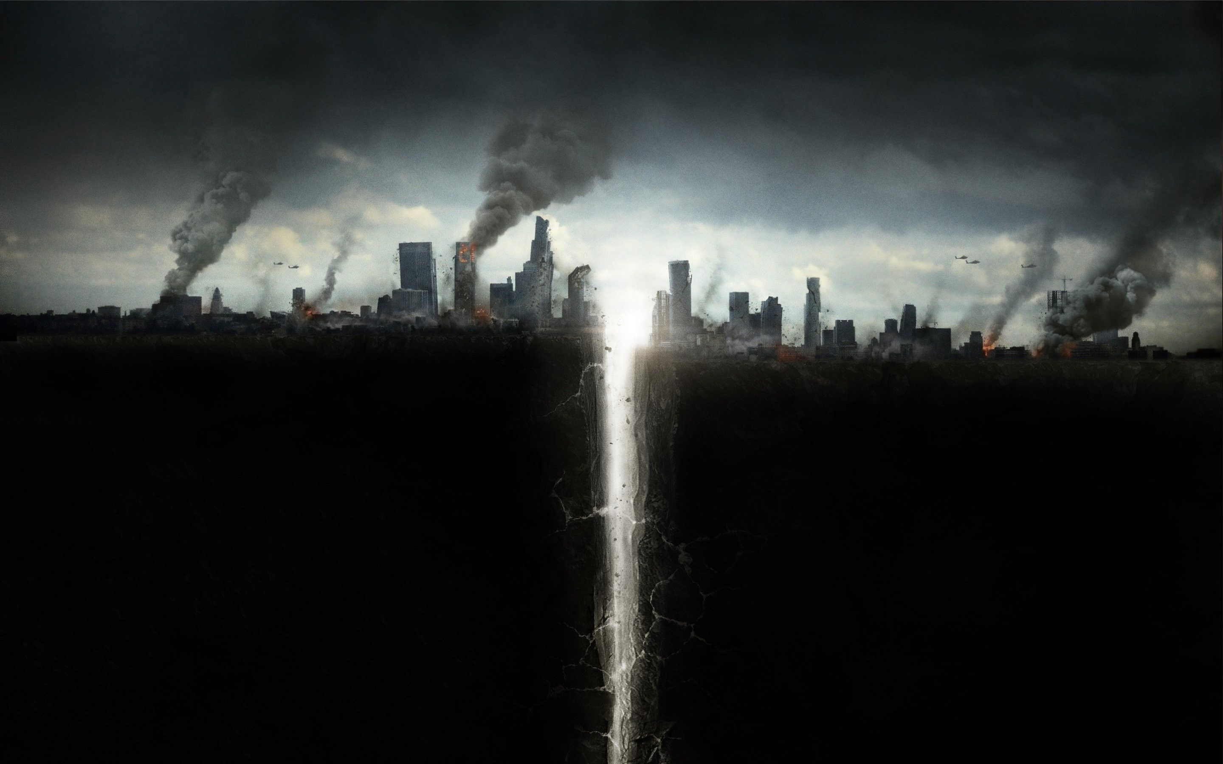
Submitted by: Irfan zafar
Submitted to: Dr.Fiaz
Roll no: BHIF19E008
Department: Hisory
Semester: 7th (ss)

Slide 2
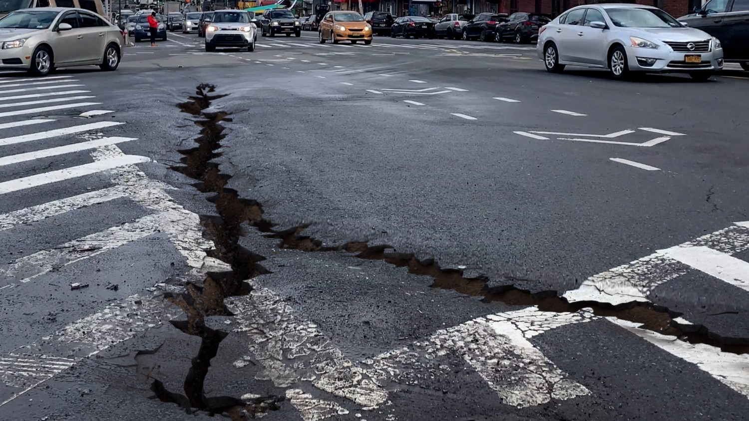
Hurricanes and Earthquake

Slide 3
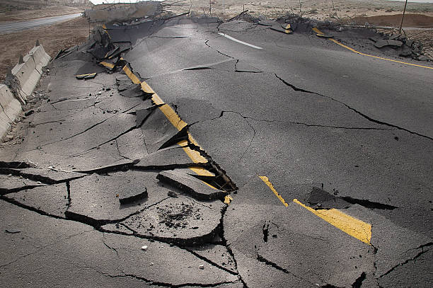
Earthquake
An earthquake is a sudden, rapid shaking of the Earth caused by the release of energy stored in rocks that have been under tension for a long time.
Earthquakes can cause buildings to collapse, ground to crack, and tsunamis to form. They can also cause landslides, avalanches, and other types of destruction.

Slide 4
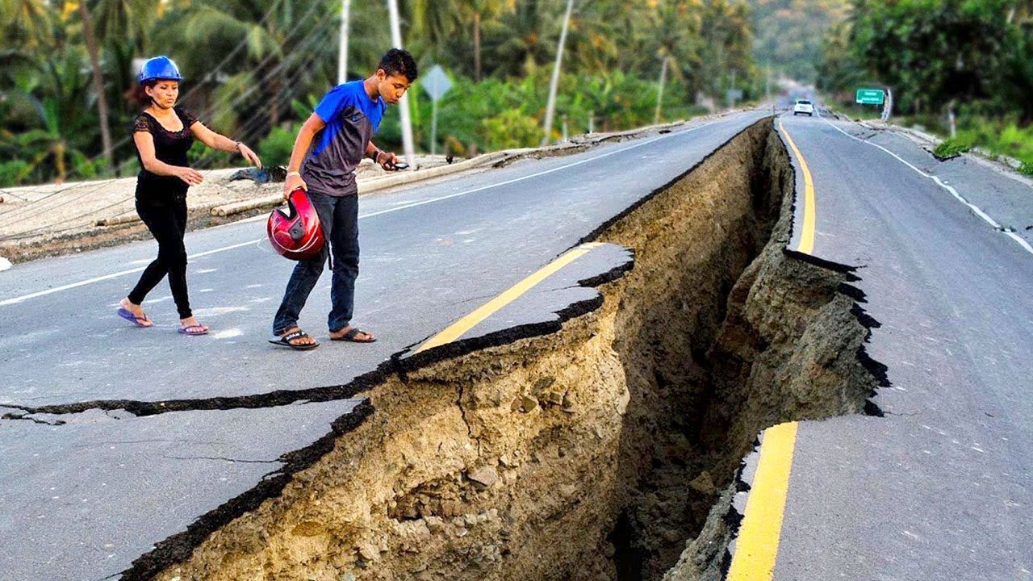
Fun and Facts
Earthquakes can happen anywhere in the world, but they are most common in the Ring of Fire.
Earthquakes can last from a few seconds to several minutes, and the intensity can range from barely noticeable to catastrophic.

Slide 5
cont...
Animals can often sense an impending earthquake before humans. Dogs, cats and other animals have been known to act strangely before an earthquake hits.
Earthquakes can cause tsunamis, which are giant waves created by the displacement of large amounts of water. Tsunamis can reach heights of over 100 feet and travel at speeds of over 500 mph.

Slide 6
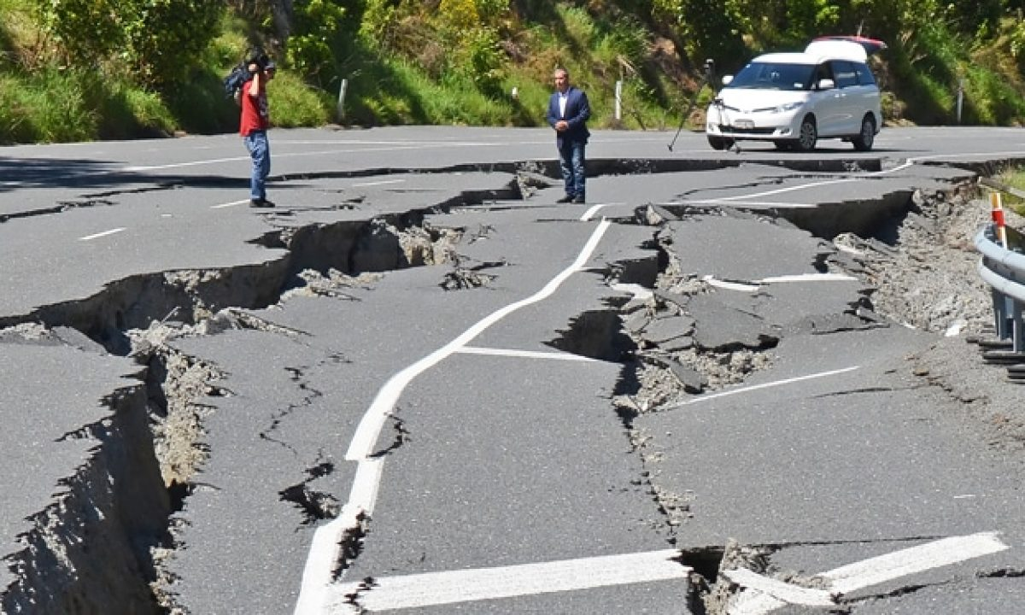
Some major causes of Earthquakes
Plate Tectonic Movements: Earthquakes occur when two tectonic plates collide or rub against each other.
Volcanic Activity: Earthquakes can also be caused by volcanic activity.
Landslides: When large amounts of earth and rock move rapidly down a slope, it can cause the ground to shake and create an earthquake.

Slide 7
Strength of Earthquakes
The strength of an earthquake is measured by the Richter scale, which is a measure of the magnitude of the earthquake. Earthquakes with a magnitude of 5.0 or greater are typically considered to be strong earthquakes.

Slide 8
Effects of Earthquakes
Ground shaking: This is the most common direct effect of an earthquake and is responsible for most of the damage caused by an earthquake.
Fires: Earthquakes can cause fires by rupturing gas lines or overturning stoves.
Tsunamis: Earthquakes can trigger tsunamis, which are giant waves that can cause destruction and loss of life in coastal areas.

Slide 9
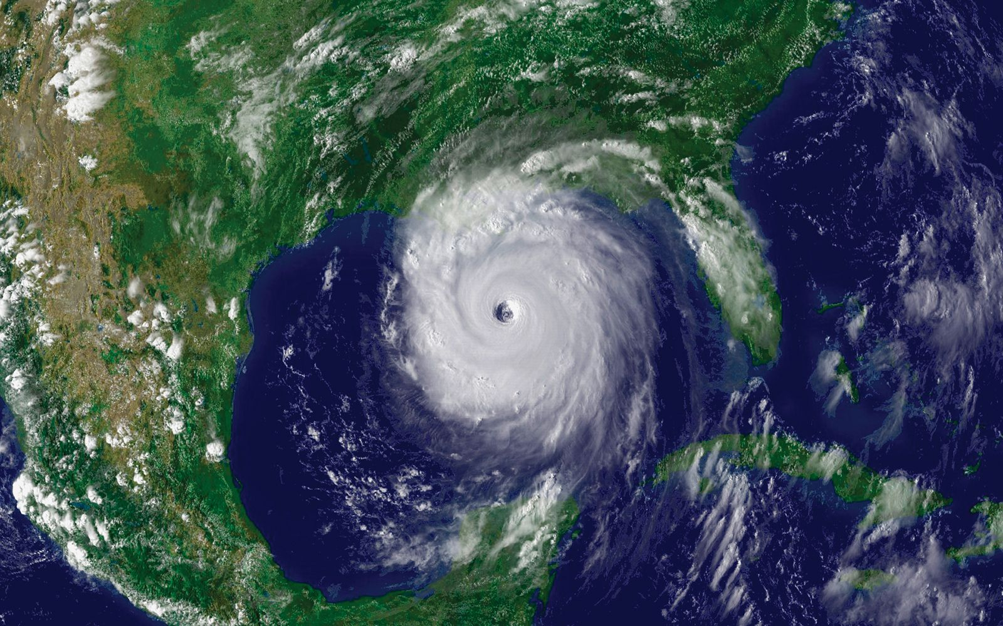
Hurricane

Slide 10
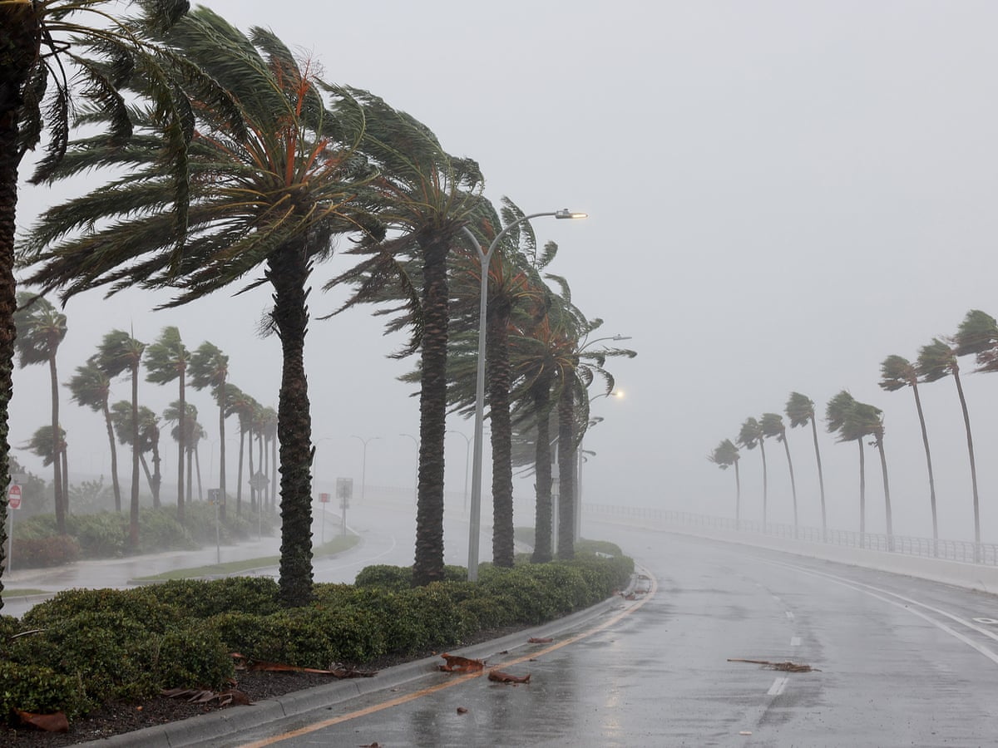
Hurricane?
A hurricane is a powerful and destructive tropical cyclone, with winds of 74 mph (119 km/h) or higher, that forms over the ocean. Hurricanes are fueled by warm, moist air from evaporated ocean water and can cause catastrophic damage, especially when they make landfall.

Slide 11
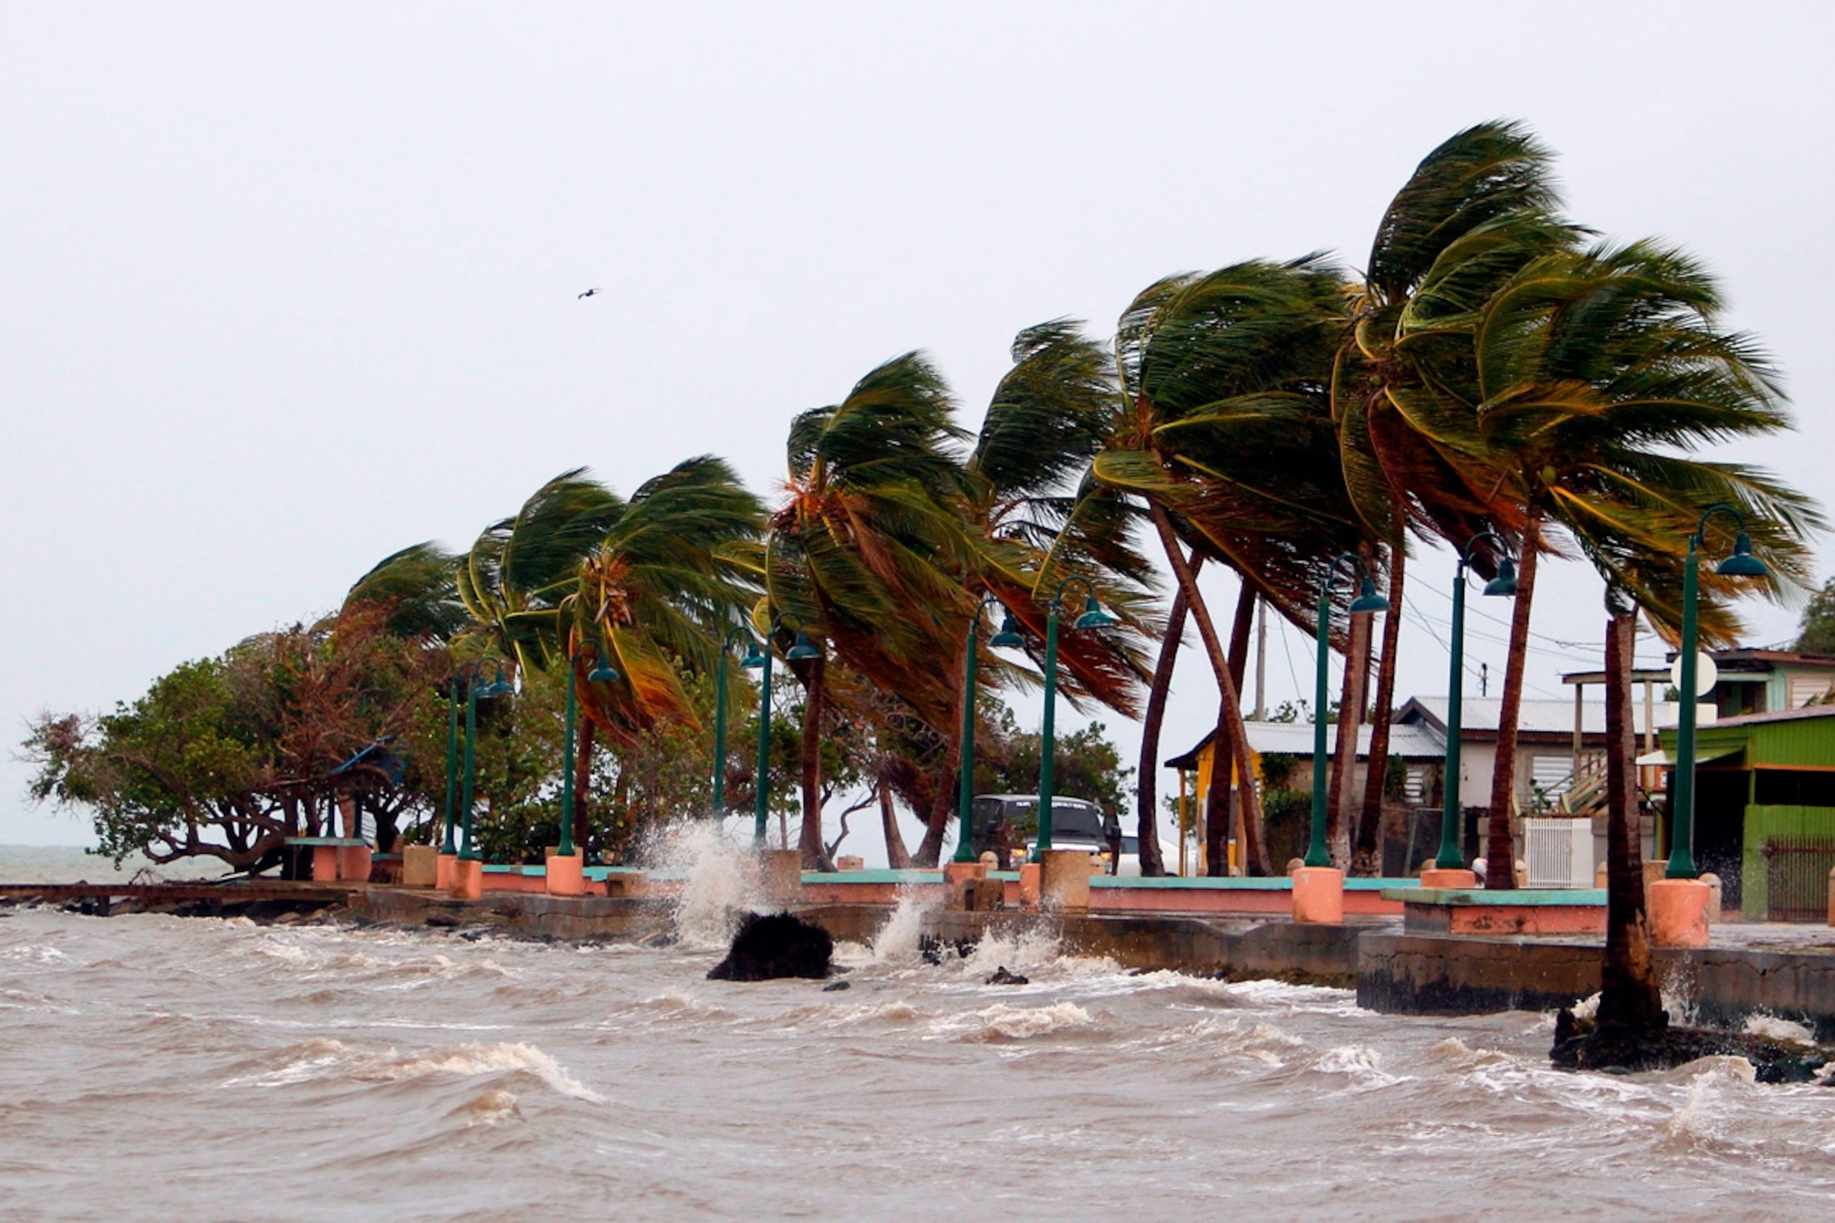
Parts of Hurricane
Low Pressure Center: The low pressure center, or eye, is the area within a hurricane with the lowest atmospheric pressure.
Eye Wall: The eye wall is the ring of thunderstorms and high winds that surrounds the low pressure center of a hurricane.
Feeder Bands: These are bands of thunderstorms that move around the storm, providing energy and moisture to the hurricane.

Slide 12
Hurricanes Form
Hurricanes form when warm ocean water evaporates and rises into the atmosphere. This warm air rises and is replaced by cooler air that also rises. As the warm air rises, it begins to rotate, creating an area of low pressure. As more air rushes in to fill the low pressure area, it causes the spinning air to gain strength and speed. Eventually, the spinning air forms an organized storm system that can become a hurricane.

Slide 13
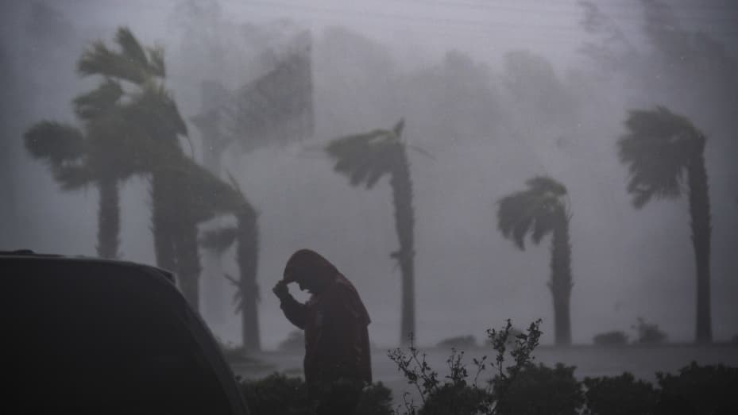
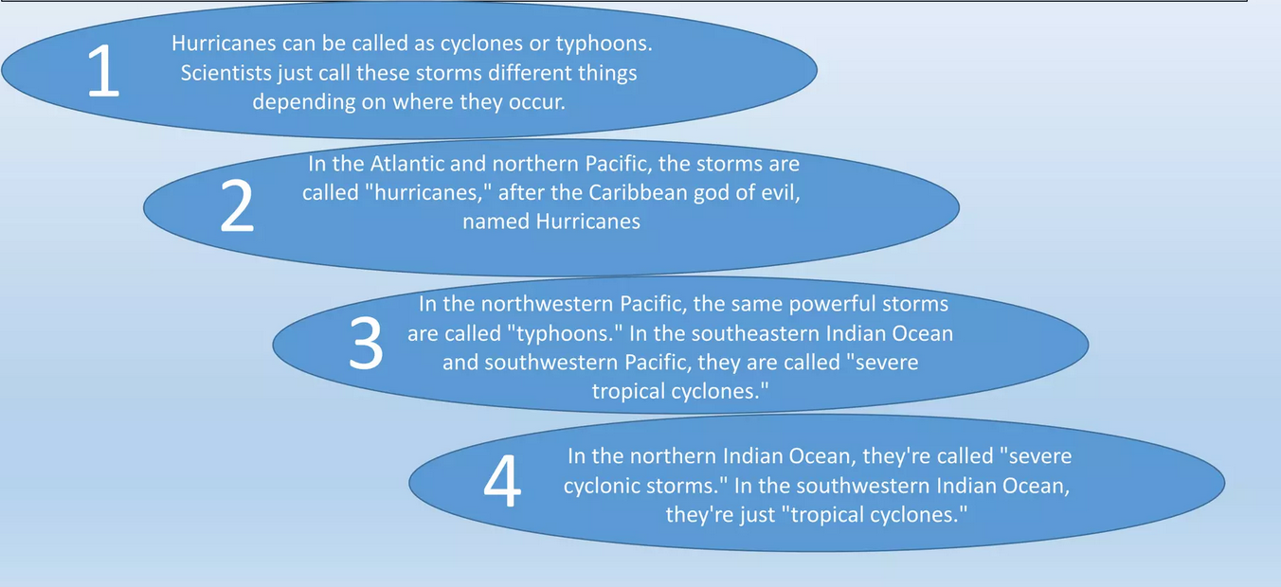
Points to remember

Slide 14
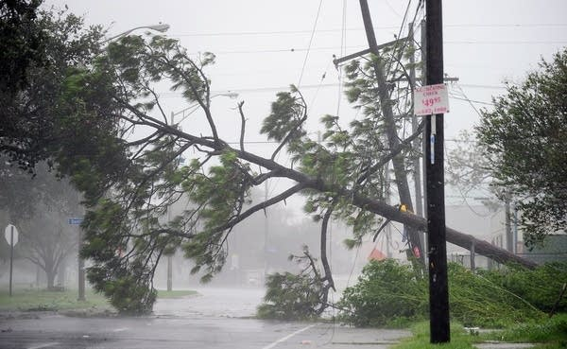
Damage and Effects
The effects of hurricanes can be devastating and can have long-lasting consequences. Hurricanes can cause extensive damage to property, including homes, buildings, and infrastructure. They can also cause power outages, flooding, and extreme winds that can cause severe damage to trees, power lines, and other structures. Hurricanes can also cause storm surge, a sudden increase in sea level that can cause extensive flooding and destruction of coastal areas. In addition, hurricanes can produce powerful winds, tornadoes, and other forms of severe weather that can cause additional destruction.

Slide 15
Conclusion
Hurricanes:
The devastating effects of hurricanes can have long-term impacts on communities, causing destruction to buildings, flooding, power outages, and loss of life. The best way to help prevent further destruction is to be prepared and to listen to the warnings of emergency officials.
Earthquakes:
Earthquakes are an unpredictable and destructive force of nature that can cause a lot of damage. They can occur anywhere in the world and are difficult to predict. We can, however, reduce the risk by being prepared and understanding what to do in the event of an earthquake.

Slide 16
References
Ampuero, J-P. (2018). Earthquake seismology. Princeton University Press.
Lay, T., Ammon, C.J., & Kanamori, H. (2005). Modern Global Seismology. Academic Press.
Kanamori, H., & Anderson, D.L. (1975). Theoretical basis of some empirical relations in seismology. Bulletin of the Seismological Society of America, 65(5), 1073-1095.
Daniels, J. (2006). Hurricanes: A Reference Handbook. Santa Barbara, CA: ABC-CLIO.
Blake, E. S., & Knabb, R. D. (2017). Tropical Cyclones. In S. A. Bortman (Ed.), The Encyclopedia of Natural Hazards (pp. 618-621). Springer, Cham.

